Slide 1
Student Details
Name : NAYAKANTI SAI MIHIRNATH
SkillsBuild Email ID : saimihirnath.nayakanti1@gmail.com
College Details : Manipal Institute of Technology, Manipal, Karnataka
Internship Domain : Cyber Security
Internship Start and End Date : 14/06/2023 to 24/07/2023

Slide 2



problem Statement
Develop a keylogger application with a graphical user interface (GUI) using Python. The keylogger should be able to record and capture keystrokes made by the user on the system where the application is running. The GUI should provide a user-friendly interface to start and stop the keylogger and ask for the name of the text file to store the keys.

Slide 3


AGENDA
Introduction and Setup
GUI Design
Keylogging Functionality
File Handling and User Input
Implementation Guide
Testing and Verification
Ethical and Legal Considerations

Slide 4
PROJECT OVERVIEW
Introduction and Setup:
Introduce the project and its purpose.
Explain the setup process, including the required Python libraries and dependencies.
GUI Design:
Design a graphical user interface (GUI) for the keylogger application.
Include user-friendly controls, such as buttons for starting and stopping the keylogger.
Keylogging Functionality:
Implement the keylogging functionality to capture all keystrokes made by the user.
Ensure that the keylogger records alphanumeric characters, special characters.
File Handling and User Input:
Prompt the user to enter the name of the text file where the recorded keystrokes will be stored.
Implement the file handling mechanism to write the captured keystrokes to the specified text file.
Implementation Guide:
Provide a step-by-step guide on implementing the keylogger application with a GUI.
Explain the code structure and logic behind keylogging and file handling.
Testing and Verification:
Conduct thorough testing to ensure the proper functioning of the keylogger and GUI.
Verify that the captured keystrokes are correctly written to the specified text file.
Ethical and Legal Considerations:
Highlight the importance of ethical use of the keylogger application.
Discuss the legal considerations, such as obtaining appropriate permissions and informing users about the presence of the keylogger

Slide 5
WHO ARE THE END USERS of this project?
Software developers seeking to learn about keylogger implementation and GUI development in Python.
Security professionals, such as ethical hackers or penetration testers, using the keylogger for legitimate security assessment purposes.
Educational institutions incorporating the project as a practical exercise in programming, cybersecurity, or ethical hacking courses.
Researchers studying human-computer interaction, behavior analysis, or related fields that require keystroke data for their studies.
System administrators using the keylogger for monitoring and troubleshooting purposes within their organizations.

Slide 6

YOUR SOLUTION AND ITS VALUE PROPOSITION
Our keylogger project with a GUI offers a user-friendly interface to start and stop the keylogger and allows users to specify the name of the text file for storing the recorded keystrokes. The benefits include simplicity, customization, learning opportunities, security and compliance, and monitoring capabilities. It provides a convenient and customizable way to capture and analyze keystrokes while promoting ethical and legal usage.

Slide 7
How did you customize the project and make it your own
A normal professional keylogger operates stealthily, capturing keystrokes without user awareness. It lacks a GUI and emphasizes discreet logging for security purposes. In contrast, my project features a user-friendly GUI, allowing users to easily interact with the keylogger. It offers customization by enabling users to specify the text file name for storing recorded keystrokes. Ethical considerations are paramount, as my project emphasizes consent, permissions, and informing users about the keylogger's presence to ensure compliance with privacy laws. Additionally, it serves as an educational resource for developers, students, and researchers, illustrating keylogger implementation with a GUI and providing insights into keylogging techniques, GUI design, and ethical implications. By prioritizing usability, customization, ethics, and education, my project sets itself apart from a normal professional keylogger.

Slide 8
MODELLING
3. File Handling:
Upon pressing the "Stop Keylogger" button, the program prompts the user to enter a filename for storing the recorded keystrokes.
The captured keystrokes are then written to the specified text file.
4. User Interaction:
Users can interact with the keylogger through the GUI buttons to initiate and terminate keylogging.
5. Security and Ethical Considerations:
The code lacks specific security measures such as encryption and access control to protect the recorded data.
Ethical considerations are addressed by asking for user consent before saving the keystrokes.
Overall, the keylogger project with a GUI provides a basic keylogging solution with a user-friendly interface. However, to ensure responsible usage, additional security measures and privacy considerations should be implemented.
The keylogger project in Python with a user-friendly GUI is designed to capture and store keystrokes while offering a straightforward interface for users:
1. Graphical User Interface (GUI):
The project utilizes Tkinter to create a simple GUI window.
It includes "Start Keylogger" and "Stop Keylogger" buttons, enabling users to control the keylogging process.
2. Keylogger Functionality:
The keylogger_listener variable represents the listener for capturing keystrokes using `pynput` library.
When the "Start Keylogger" button is pressed, the keylogger_listener starts recording keystrokes and stores them in the key_logs list.

Slide 9
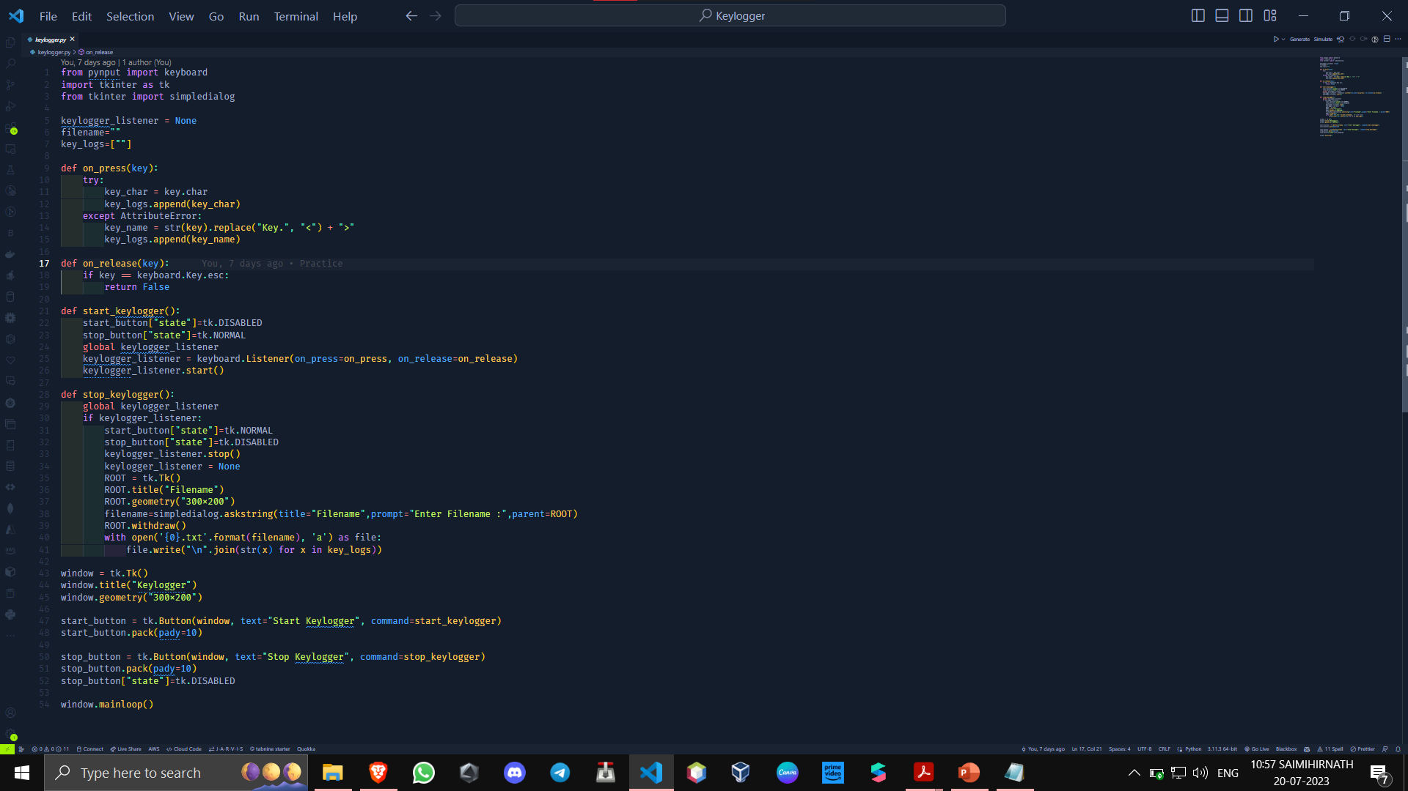

Slide 10
Results
The keylogger project with a GUI successfully captures and logs keystrokes. Users can easily start and stop the keylogger while specifying the text file name for storage. Ethical compliance, user-friendliness, and learning opportunities make it valuable for developers, students, and researchers.
Here’s the link to the Project Code and the Results file
Click Here

Slide 11

links
https://docs.python.org/3/library/tkinter.html
https://pynput.readthedocs.io/en/latest/
https://skillsbuild.edunetworld.com/courses/cs/keylogger-capturing-key-strokes/
https://chat.openai.com/

Slide 12


